Slide 1
Delaunay Tessellation of Proteins:
Four Body Nearest Neighbor
Propensities of Amino Acid Residues
Raj K. Singh, Alexander Tropsha and Iosif I. Vaisman*
J. Comput. Biol. 1996, 3, 2, 213-222
Speaker: Cha-Hong Chang

Slide 2
Abstract
Delaunay tessellation is applied for the first time in the analysis of protein structure. By representing the location of amino acid residues in protein chains by Cα atoms, the protein structure is described as a set of points in three-dimensional space. Delaunay tessellation of a protein structure generates an aggregate of space-filling irregular tetrahedra, or Delaunay simplices. The vertices of each simplex define objectively four nearest neighbor Cα atoms, i.e. four nearest neighbor residues.

Slide 3
Abstract(con’t)
A simplex classification scheme is introduced in which simplices are divided into five classes based on the relative positions of vertex residues in the protein primary sequence. Statistical analysis of the residue composition of Delaunay simplices reveals nonrandom preferences for certain quadruplets of amino acids to be clustered together. This nonrandom preference may be used to develop a four-body potential that can be used in evaluating sequence-structure compatibility for the purpose of inverted structure prediction.

Slide 4
Introduction
Improve recent method
  Potential energy function
Def. of nearest neighbor
  Yee : 5.5
  Behe : 2.8
  Etc.
Above are not objective
  Drawback : chosen criteria

Slide 5
Methods
Determine the DT of a set of points in 3D
Use only the Cα atoms for each residue
1st step :
  Extract the set of coordinates
2nd :
  qhull
3rd :
  qstat

Slide 6
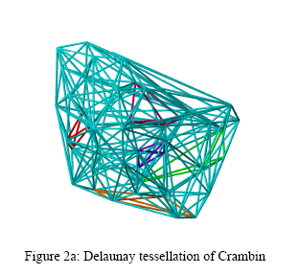

Slide 7
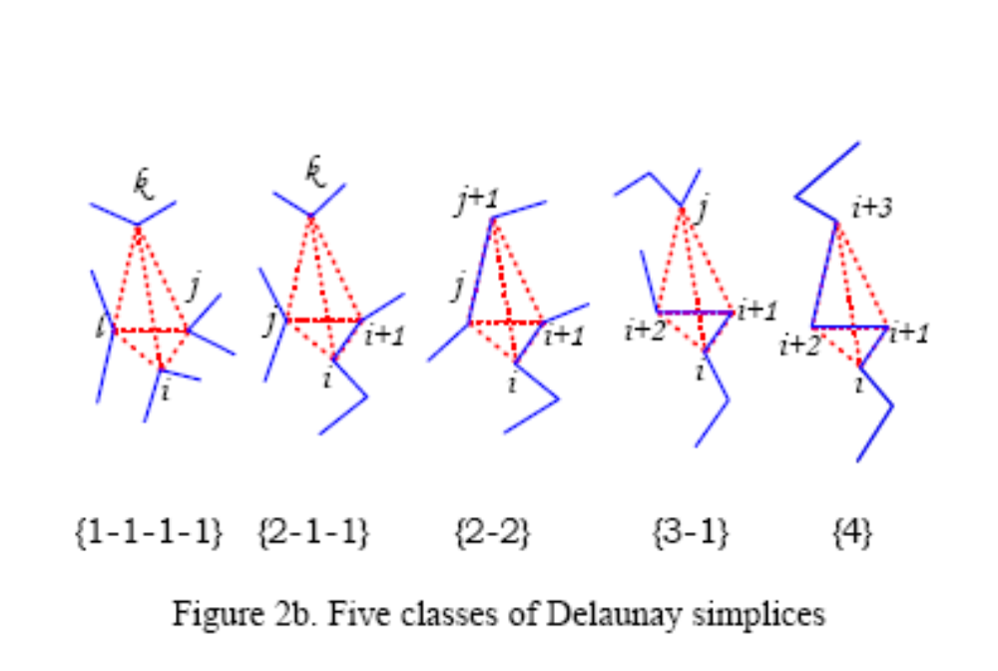

Slide 8
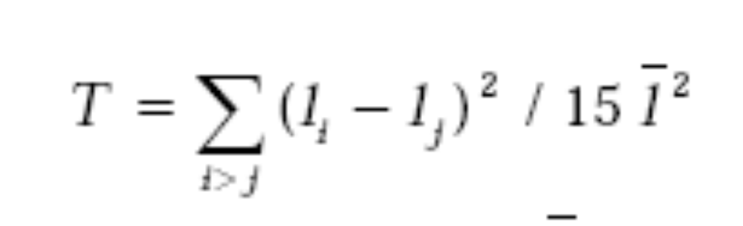
Results and discussion
Tetrahedrality :
  Degree of distortion

Slide 9
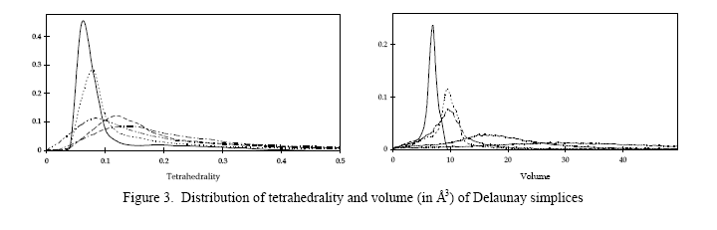

Slide 10
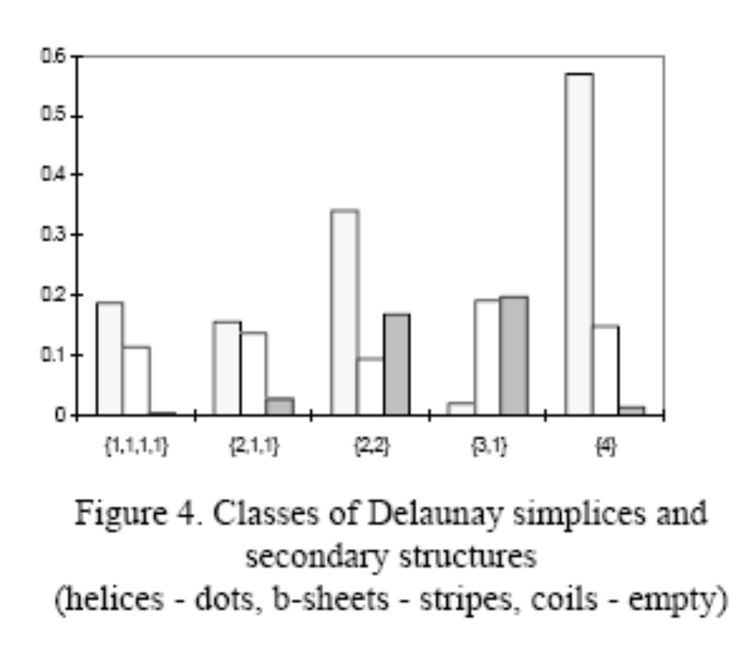

Slide 11
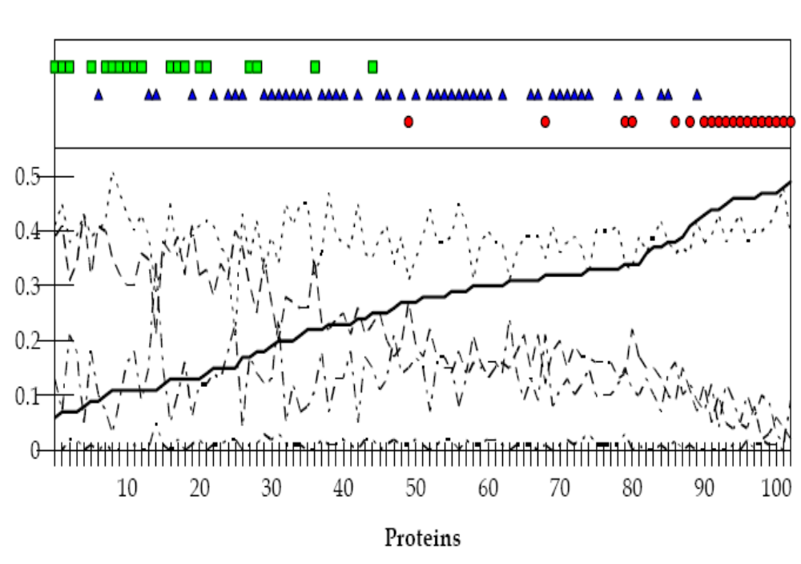

Slide 12
Figure 5. Classes of Delaunay simplices and protein fold families. Contents of simplices of class {4} (solid line), class{3,1} (dash), class {2,1} (dot), class {2,1} (dash-dot), class {1,1,1,1} (dash-dot-dot). Upper part of the figure displays fold family assignment: all-alpha (circles), all-beta (squares), and alpha-beta (triangles).

Slide 13
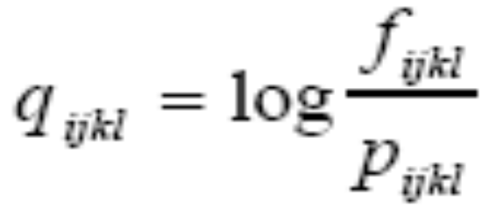
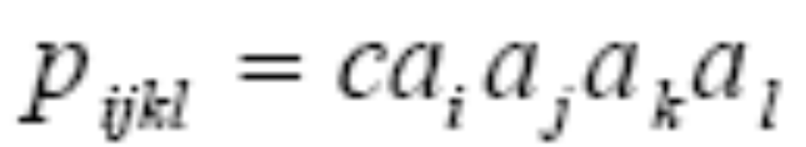
Log-likelihood factor

Slide 14
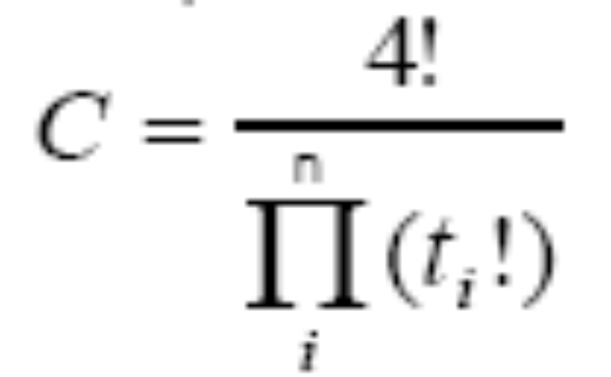

Slide 15
Conclusions
Statistical analysis of the composition of the Delaunay simplices and implications for inverted structure prediction.
Greatly benefit from rigorous def.
Objective & robust

